Slide 1

AQI Tracker Using Random Forest Regression
Sharayu Mahajan 22107051 Kalpana Mohanty 22107059
Rishi Mane 22107063
Avadhoot Virkar 22107064
Project Guide
Prof. Dipali Gat

Slide 2
Outline
Introduction
Literature Survey of the existing systems
Limitations of the existing systems
Problem statement
System Design
Technologies and methodologies
Implementation
Conclusion
References

Slide 3
Introduction
AI-powered system for real-time air quality monitoring.
Utilizes APIs to predict AQI of worldwide cities accurately & also Weather .
AQI Tracker enhances awareness through pollution and weather forecasts.
Improves safety with AI-driven analysis and alert-based monitoring.
1.1 Motivation
Real-time air quality monitoring enhances environmental awareness and public health.
Utilizes AI to provide accurate forecasts and timely pollution alerts.

Slide 4
1.2 Objectives
To predict the Air Quality Index (AQI) & weather prediction of various cities around the world using live data from trusted online sources.
To forecast future air quality trends based on historical data and machine learning, helping users take preventive measures in advance.
To sort air quality into standard health-based categories like Good, Moderate, or Unhealthy, and alert users quickly if it becomes unsafe.
To study ongoing patterns in air quality and weather to better identify long-term environmental trends and regional differences by Visualization graphs .

Slide 5
Literature Survey of the existing system
Title and Year of publication | Author Name | Methodology | OUTCOME | Conclusion
[1] “Prediction of Air Quality Index Using Machine Learning Techniques: A Comparative Analysis” 2023 | N. Srinivasa Gupta,Yashvi Mohta,Khyati Heda,Raahil Armaan,B. Valarmathi,and G. Arulkumaran | A study examined air indicators (e.g., AQI, PM2.5, NOx) and used SVR for prediction. Results highlight pollutants like sulfur dioxide, nitrogen dioxide, ozone, and PM2.5. | Balancing the dataset through SMOTE improved model accuracies across support vector regression, random forest regression, and CatBoost regression, as evidenced by increased R- SQUARE and decreased MSE, RMSE, and MAE, particularly notable in New Delhi, Bangalore, Kolkata, and Hyderabad. | Balancing datasets with SMOTE significantly improves accuracy in predicting AQI using machine learning models, with random forest regression and CatBoost regression consistently outperforming SVR in India's major cities.

Slide 6
Literature Survey of the existing system
Title and Year of publication | Author Name | Methodology | OUTCOME | Conclusion
[2] “A Study and Analysis of Air Quality Index and Related Health Impact on Public Health” 2020 | Pranav Shrirama and Srinivas Malladib | The methodology uses gas sensors and an ADuC812 device to measure CO, NO₂, SO₂, and O₃, calculating the air quality index. AI and statistics monitor PM2.5 and PM10 levels near schools, with a smart system alerting parents, teachers, and medical staff when air quality exceeds standards. | The study highlights research gaps in air pollution, AQI, and public health, stressing real-time monitoring and preventive measures for urban commuters. | Existing systems provide air quality index information but lack in addressing health impacts adequately, necessitating a more nuanced understanding of specific air pollutants' effects on different parts of the body for effective preventive measures.

Slide 7
Literature Survey of the existing system
Title and Year of publication | Author Name | Methodology | OUTCOME | Conclusion
3] “Air Quality index – A Comparative Study for Assessing the Status of Air Quality” 2015 | Shivangi Nigam, B.P.S. Rao, N. Kumar, V. A. Mhaisalkar | Real-time air quality monitoring at NEERI, Nagpur, used an Environment S.A CAAMS Analyzer to measure PM10, PM2.5, SO2, and NO2, employing advanced calibration methods. | The outcome highlights the dominance of particulate matter, especially PM10, in contributing to poor air quality in the residential site NEERI, Nagpur, emphasizing the urgent need for effective pollution control and management strategies to address public health concerns and promote civic well- being. | The conclusion underscores the urgent need for robust pollution control measures, particularly focusing on particulate matter like PM10, to mitigate the severe public health risks associated with air pollution in residential areas like NEERI, Nagpur.

Slide 8
Limitations of existing systems
Generalizability: SMOTE-balanced dataset‘s effectiveness may vary outside major Indian cities due to diverse pollution and population dynamics.
Wellness Target: Existing systems often lack specificity in addressing health outcomes, hindering tailored preventive measures against air pollution.
Implementation Challenges: Urgent pollution control measures face hurdles like resource availability and community engagement, especially in residential areas like NEERI, Nagpur.

Slide 9
Problem Statement
Air pollution poses significant health risks and environmental challenges in many regions worldwide. However, the lack of accurate and timely information on air quality often hinders effective pollution control measures and proactive health precaution.
The gap in information availability and accuracy underscores the need for a robust AQI tracker that can deliver precise forecasts, increase public awareness, and support authorities in implementing targeted pollution control strategies.

Slide 10
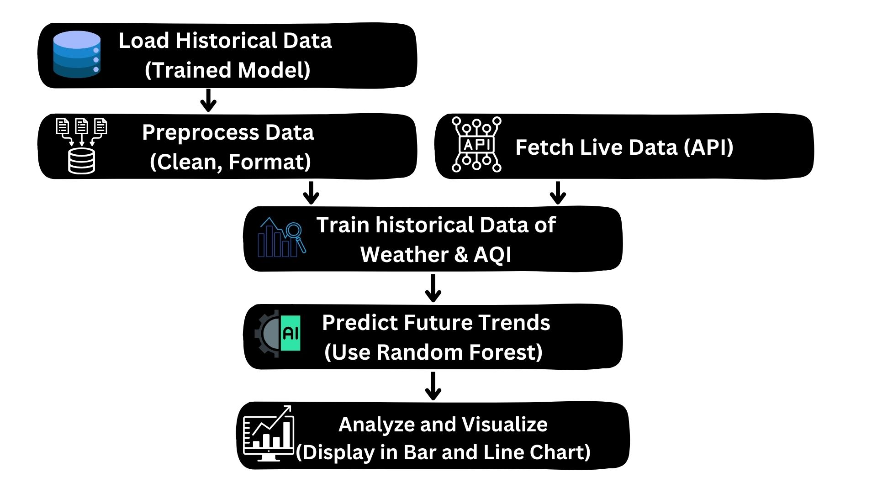
System Design

Slide 11
Technologies and Methodologies
Software:
Python 3.13.2
HTML5
CSS3
Python Libraries: Flask, matplotlib, numpy, pandas, sklearn
Datasets:
Kaagle dataset of Weather and AQI
Methodology:
Random forest regression model
.

Slide 12

Implementation
Fig 1: Home Page

Slide 13
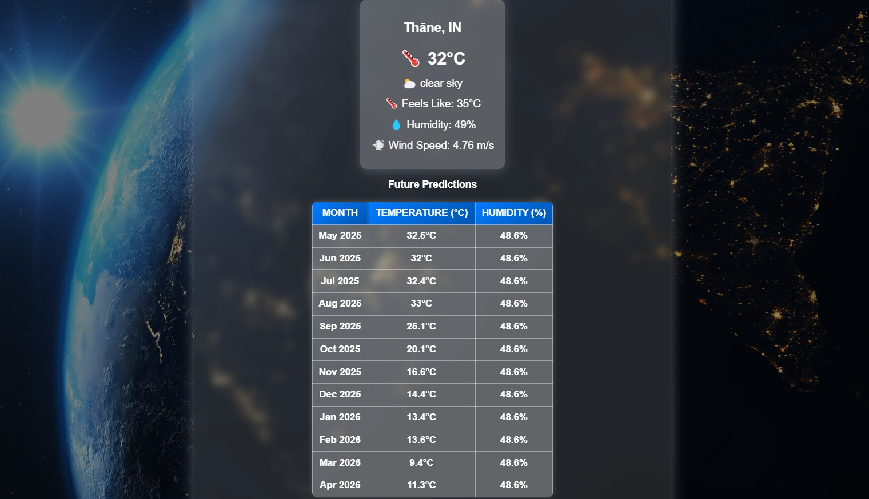
Fig 2: Weather Forecasting

Slide 14


.
Fig 3: AQI Tracker

Slide 15
Conclusion
In conclusion, the AQI forecast and Weather forecast project aims to provide accurate and reliable predictions of Air Quality Index (AQI) levels by leveraging machine learning algorithms.
By preprocessing and analyzing relevant data, training various models, and selecting the best-performing one, the project seeks to address challenges in air quality prediction.
Through continuous monitoring and evaluation, the deployed model will contribute to informed decision-making for public health and environmental management, ultimately improving air quality and safeguarding community well-being.

Slide 16
References
[1] “Prediction of Air Quality Index Using Machine Learning Techniques: A Comparative Analysis” 2023
[2] “A Study and Analysis of Air Quality Index and Related Health Impact on Public Health” 2020
[3] “Air Quality Index – A Comparative Study for Assessing the Status of Air Quality” 2015

Slide 17
Thank You...!!

